Slide 1
Amateur Radio for Packet-Based Communication with Low Earth Orbit Satellites
Samuel Harkness

Slide 2
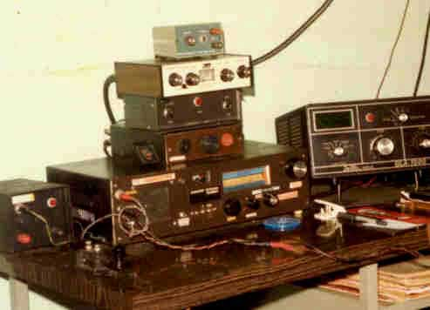
Overview
Background
Amateur Radio
Packets on Amateur Radio
Amateur Radio on Satellites
Satellite Radio System
AX.25
Radio System

Slide 3
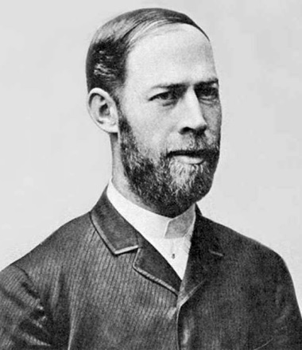
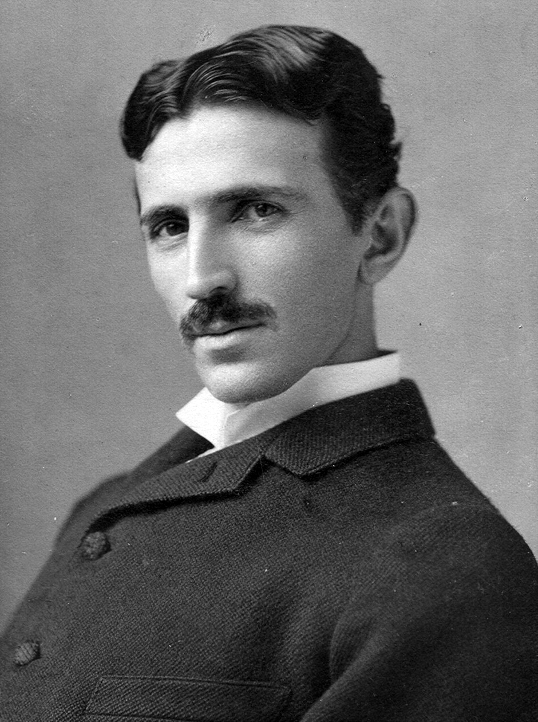
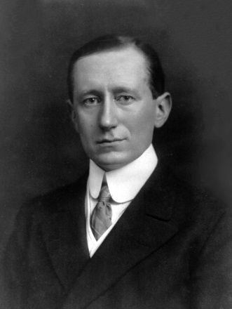
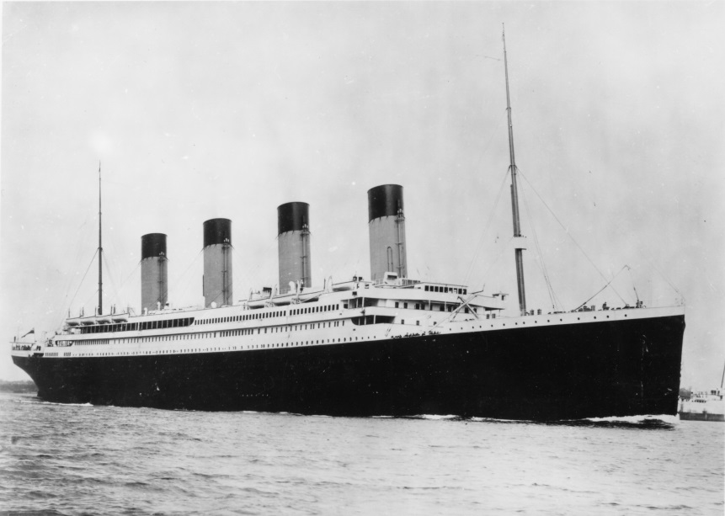
Amateur Radio
Hertz, Tesla, Marconi
Columbia University Wireless Telegraph Club
Sinking of the RMS Titanic

Slide 4
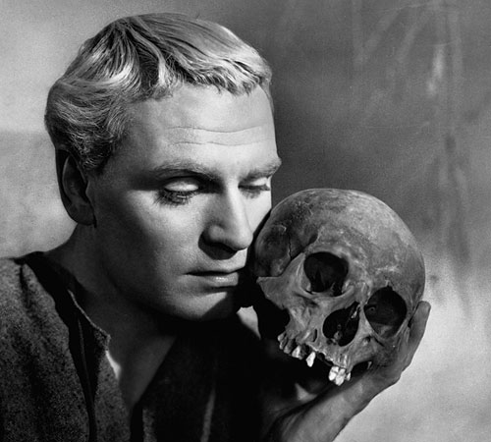
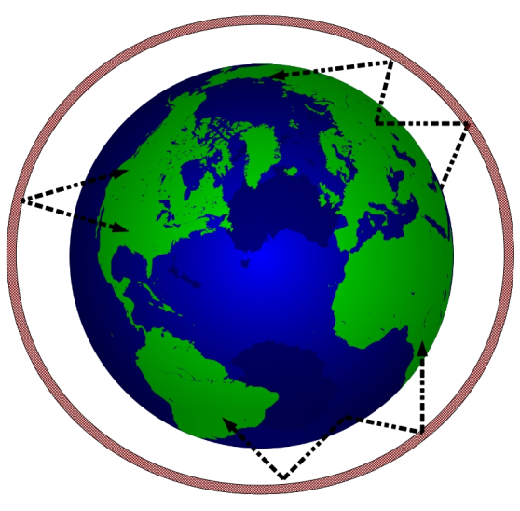
Amateur Radio
Radio Act of 1912
Private Stations restricted to 200 – 10m (1500 kHz – 30 MHz)
Shortwave Radio
Skywave Propagation
Higher data rate
Less Power
International Communication

Slide 5
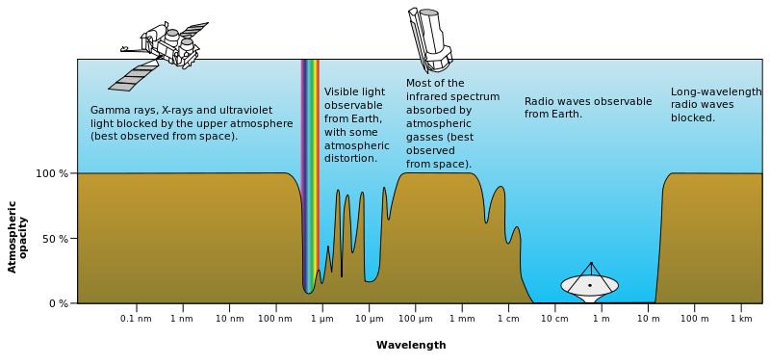
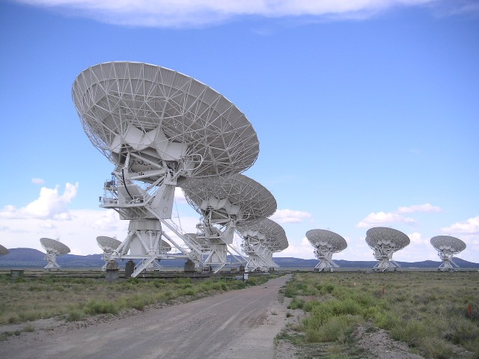
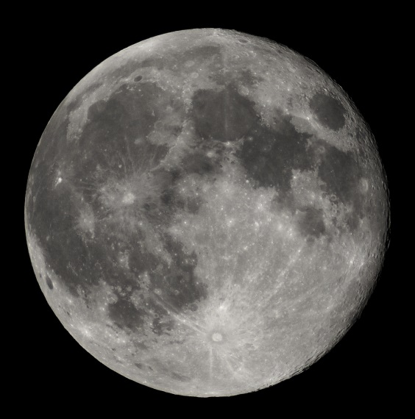
Amateur Radio
Radio Astronomy
Moon Bounce

Slide 6
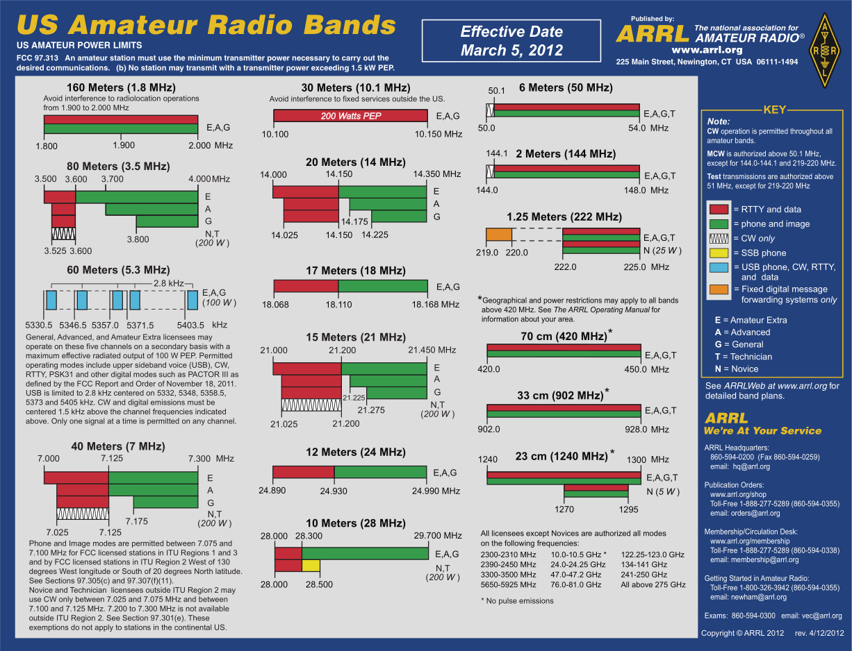
Amateur Radio

Slide 7
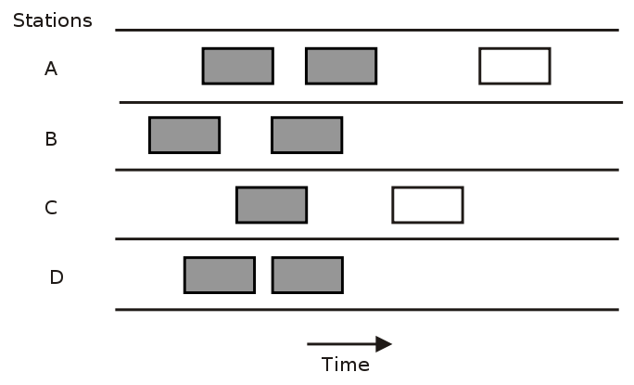

Packets on Amateur Radio
ALOHAnet
Hub Topology
Full Duplex (Two Frequencies)
PRnet
Wireless offshoot of ARPAnet
AMPRnet
Supports TCP/IP

Slide 8
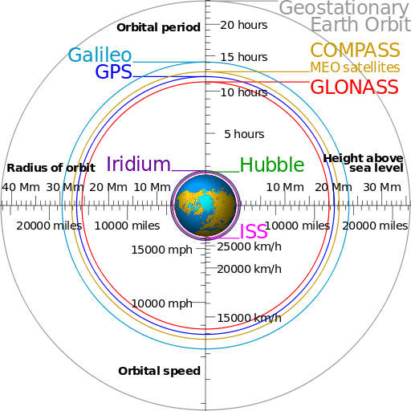
Amateur Radio on Satellites
Low Earth Orbit
160 km – 2,000 km
88 min – 127 min

Slide 9
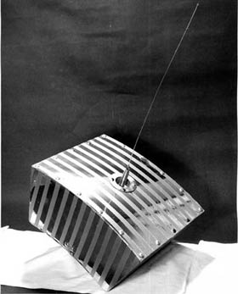
Amateur Radio on Satellites
OSCAR
12 Dec 1961
4 years after Sputnik 1
Replaced one of the balance weights
First satellite as a secondary payload
22 days, 570 hams, 28 countries
Over 70 satellites

Slide 10
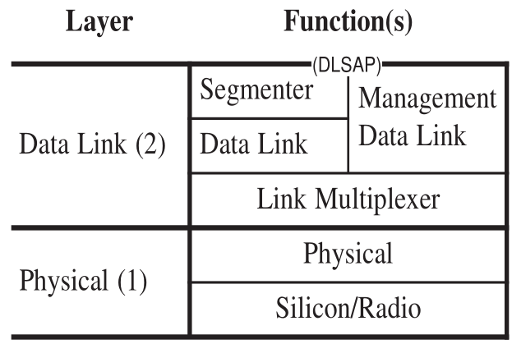
AX.25
Derived from X.25
Link Layer Protocol (Data Link Layer)
ISO 3309, 4335, 7809

Slide 11
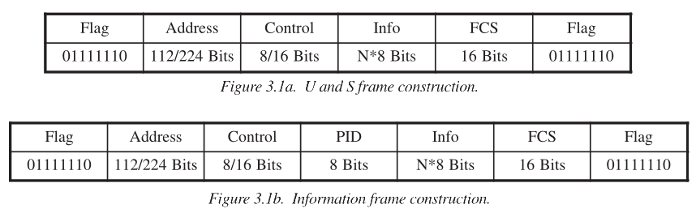
AX.25
3 General Frame Types
Information (I)
Supervisory (S)
Unnumbered (U)
Subsequent Frames can share Start/Stop Flag
Address contains Source & Destination

Slide 12
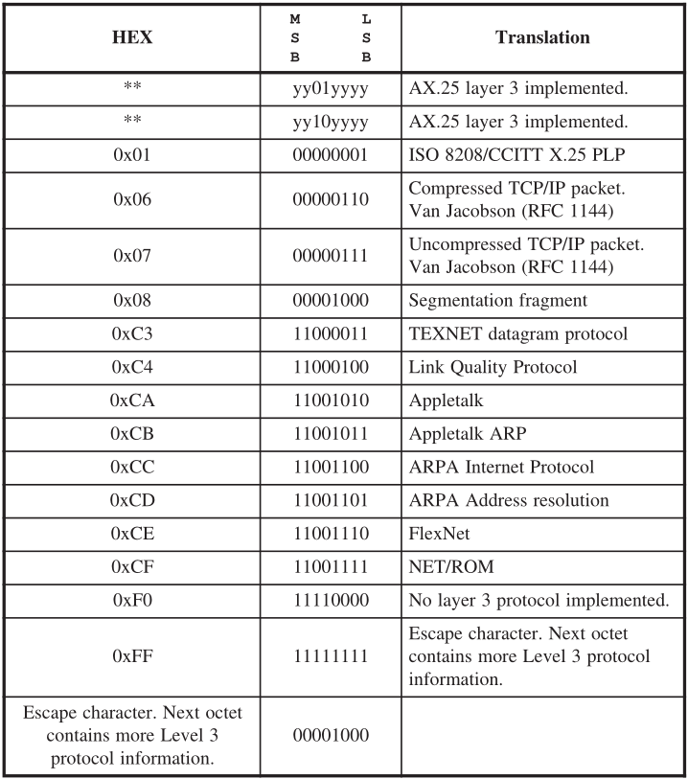
AX.25
Control determines type of frame
PID identifies the OSI Layer 3 protocol
AX.25
IP
Protects the 8-bit Flag using bit-stuffing
Frame-Check Sequence is Forward Error Correction

Slide 13
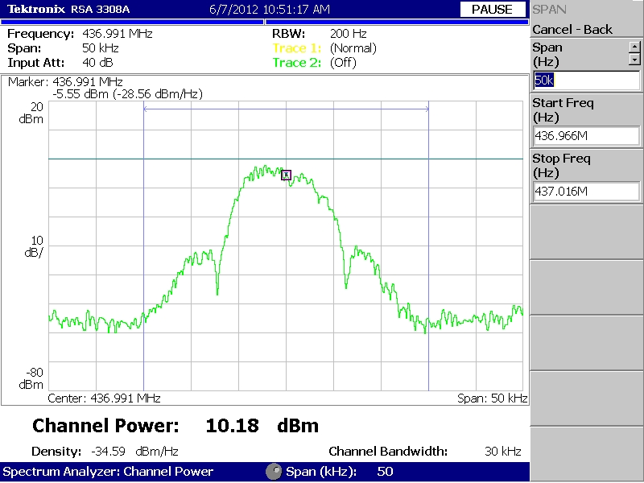
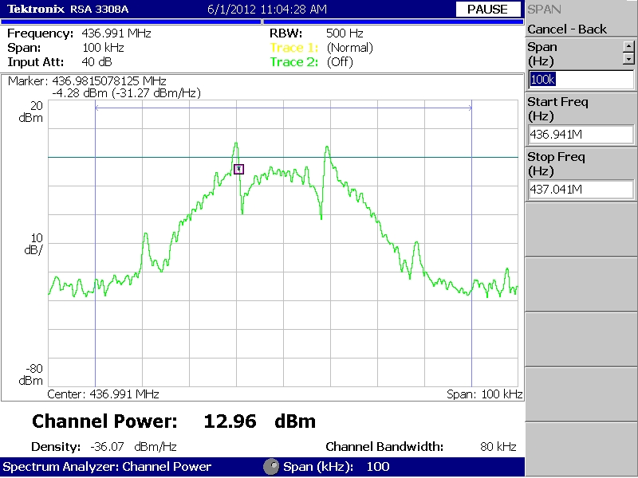
Radio
1.1W RF power
Downlink 437.000 MHz
Uplink 145.800 MHz
Frequencies change slightly mission-to-mission
Request allocation through IARU and FCC

Slide 14
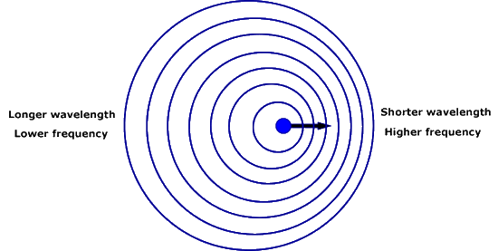
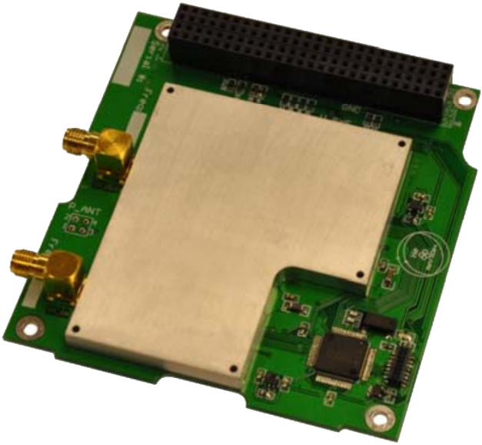
Radio
Doppler Effect

Slide 15
Radio
Beacon Mode
214 byte chunks @ 9600 bps
Period is dependent on power constraints
Downlink Mode
231 byte chunks @ 19200 bps
Can only operate Line of Sight
20 degrees above the horizon, 5 min

Slide 16
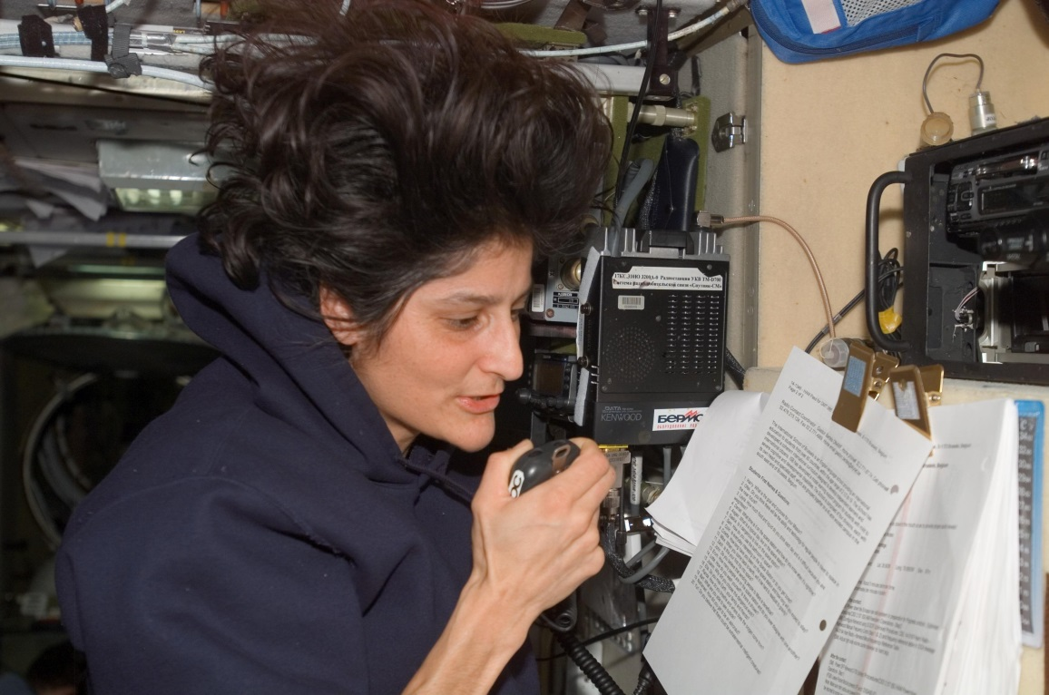
Summary
Background
Amateur Radio
Packets on Amateur Radio
Amateur Radio on Satellites
Satellite Radio System
AX.25
Radio System

Slide 17
Questions?

Slide 18
References
[1] ARRL, ed. Frequency Bands Chart. 2012. url: http://www.arrl.org/graphical-
frequency-allocations.
[2] R. Binder, N. Abramson, F. Kuo, A. Okinaka, and D. Wax. “AHOLA packet broad-
casting - A retrospect”. In: National Computer Conference. 1975.
[3] Don Bishop. Who Invented Radio? Nov. 2005. url: http://home.earthlink.net/
~ drestinblack/who_invented_radio.htm.
[4] Sean Coughlan. Titanic: The final messages from a stricken ship. Apr. 9, 2012. url:
http://www.bbc.co.uk/news/magazine-17631595.
[5] Dave Finley. Early Radio Astronomy: The Ham Radio Connection. Ed. by NRAO.
Mar. 27, 2003. url: http://www.nrao.edu/whatisra/hist_ham.shtml.
[6] Brian Kantor. “A Brief Look at Internet Networking Over Amateur Radio”. July 2011.
[7] Radio Act of 1912.
[8] K. Rawer. Wave propagation in the ionosphere. Kluwer Academic Publishing, 1993.
isbn: 0-7923-0775-5.
[9] M. Schwartz and N. Abramson. “The ALOHAnet - Surfing for Wireless Data. History
of Communications”. In: IEEE Communications 47 (12 Dec. 11, 2009).
[10] Senator William Alden Smith and Senator Isidor Rayner. ”Titanic” Disaster. 806.
Committee on Commerce United States Senate, 1912. url: http://www.titanicinquiry.
org/USInq/USReport/AmInqRep01.php.

Slide 19
References
[11] Irvin Stewart. “The International Radiotelegraph Conference of Washington”. In: The American Journal of International Law. (Oct. 4–Nov. 25, 1927). Vol. 22. 1. Jan. 1928,
pp. 28–49.
[12] The Extraordinary History of Amateur Radio Satellites. 2006. url: http://www.spacetoday.org/Satellites/Hamsats/HamsatsBasics.html.
[13] Wikipedia, ed. Skywave. Oct. 16, 2013. url: https://en.wikipedia.org/wiki/Skywave.
[14] Wireless Club at Columbia LXXVL.86 (Nov. 25, 1908). url: http://chroniclingamerica.
loc.gov/lccn/sn83030272/1908-11-25/ed-1/seq-2/.

